Slide 1
An Introduction to Natural Language Processing
Lawrence Carin
Duke University
Electrical & Computer Engineering Department

Slide 2
Lecture 1

Slide 3
What is happening today?
We are first going over the basics of “natural language processing”
Want to be able to automatically make sense of written language (whether “natural” or not!)
Later sessions will go through specific case studies
First, what can we do with natural language processing?

Slide 4


Sentiment Analysis
Machine Learning Model
“That movie was terrible!”
“This is the best jacket that I’ve ever owned”
“Not really that good.”

Slide 5
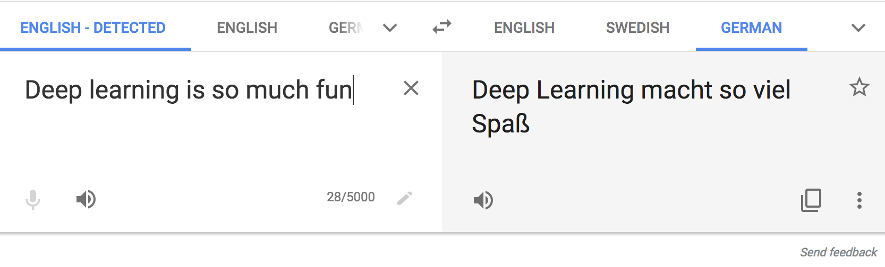
Text Translation
translate.google.com

Slide 6
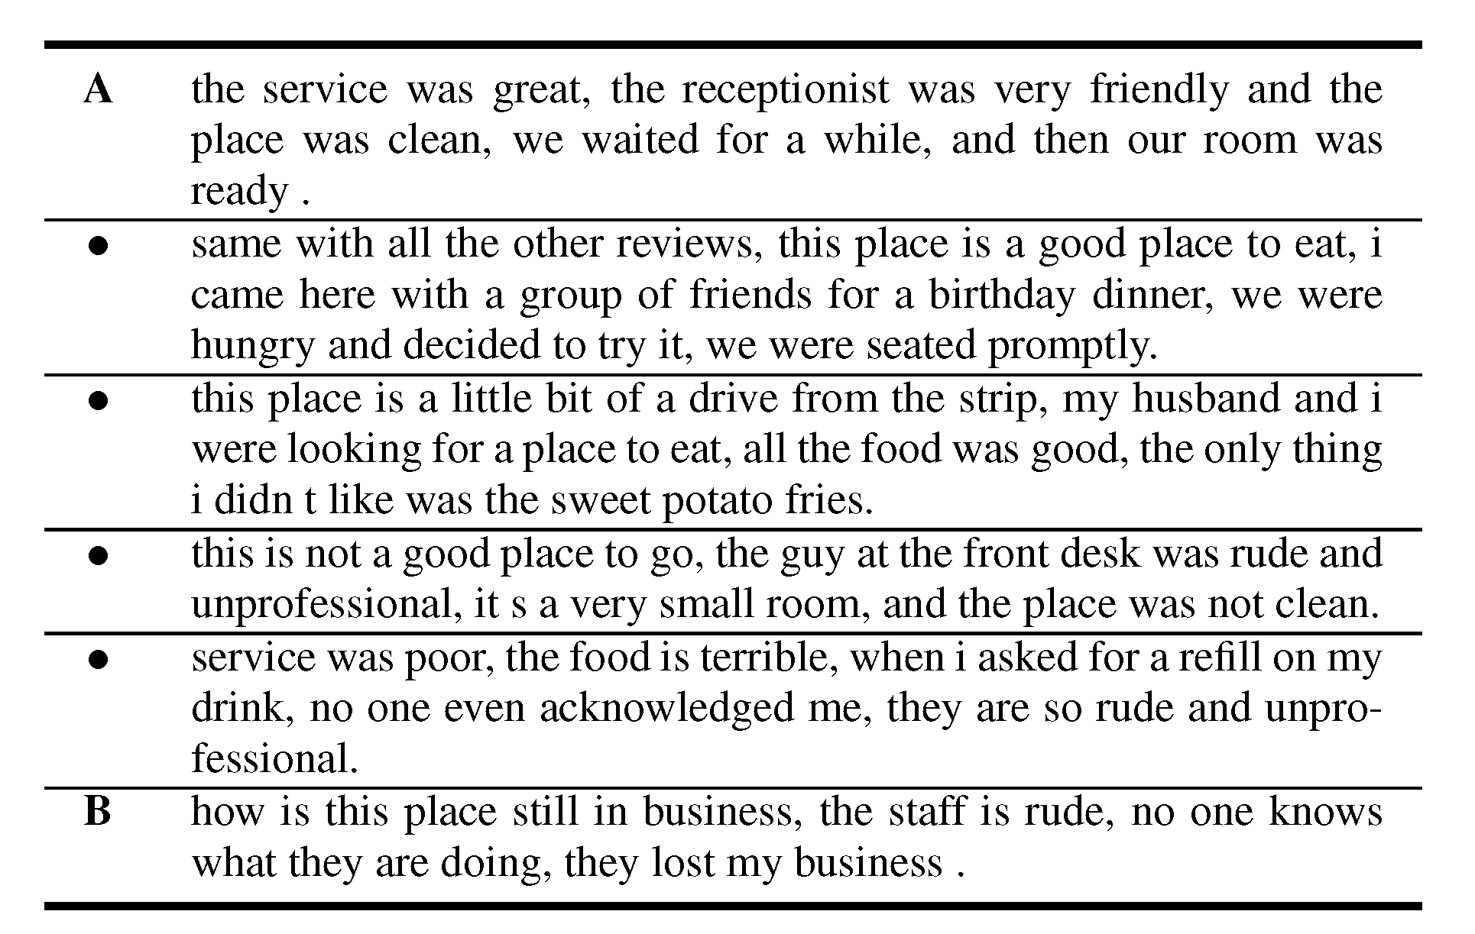
Automatic Text Synthesis

Slide 7
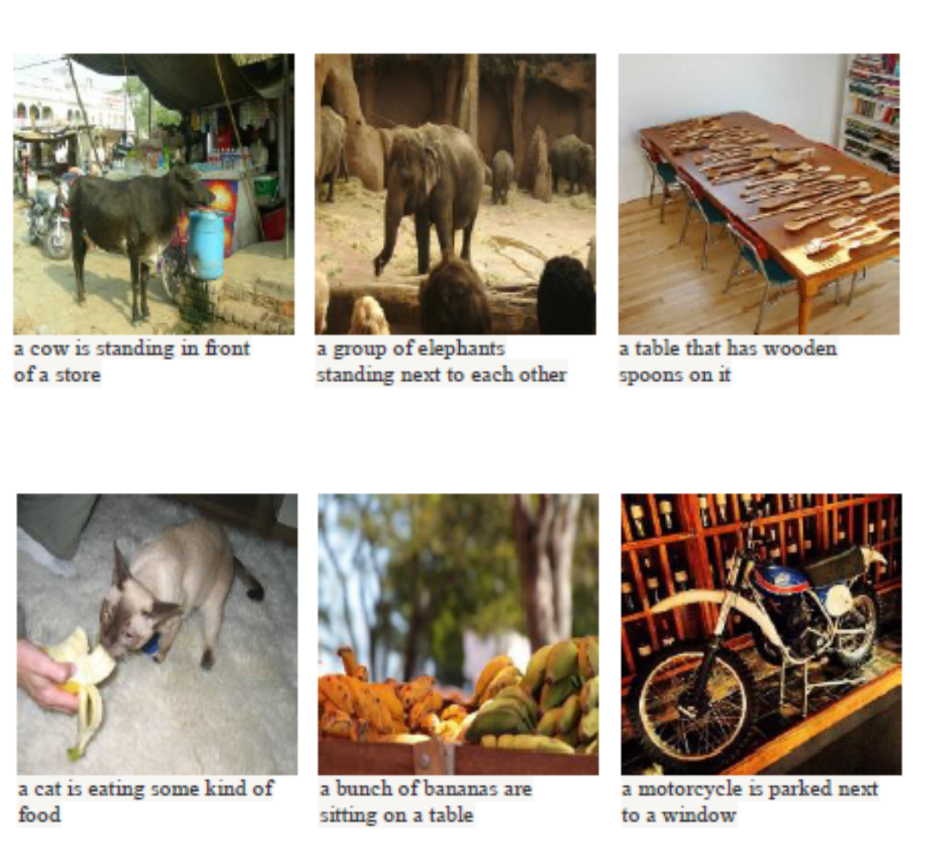
Automatic Image Captioning

Slide 8
How does this fit in our Previous Framework?

Slide 9
Sentiment Analysis
Machine Learning Model
“That movie was terrible!”
“This is the best jacket that I’ve ever owned”
“I’m pretty ambivalent about the whole thing. Not really that good.”
This is a binary classification, just like logistic regression!

Slide 10

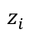
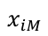
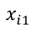
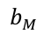
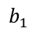
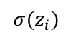
Revisiting Logistic Regression
Convert to Probability
$${σ(z}_{i})$$
$$z_{i}$$
Linear Model
$$b_{1}$$
$$b_{M}$$
$$x_{i1}$$
$$x_{iM}$$

Slide 11
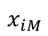
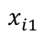
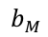
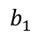
Revisiting our Linear Predictive Model
$$z_{i}$$
$$b_{1}$$
$$b_{M}$$
$$x_{i1}$$
$$x_{iM}$$
$$z_{i}=(b_{1}×x_{i1})+\left(b_{2}×x_{i2}\right)+⋯+\left(b_{M}×x_{iM}\right)$$
Big issue: we do not have a vector of features…

Slide 12
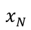
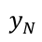
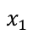
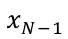
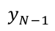
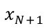
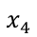
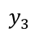
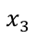
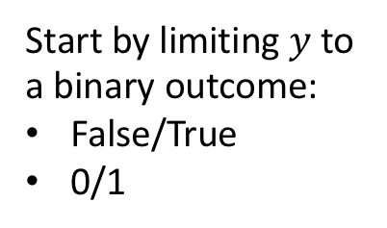
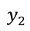
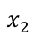
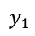
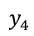
Our Previous Training Set Setup
$$x_{1}$$
$$y_{1}$$
$$x_{2}$$
$$y_{2}$$
$$x_{3}$$
$$y_{3}$$
Start by limiting $y$to a binary outcome:
False/True
0/1
$$x_{4}$$
$$y_{4}$$
$$x_{N−1}$$
$$y_{N−1}$$
$$x_{N}$$
$$y_{N}$$
New Data
$$x_{N+1}$$
?
Want to learn how to predict outcome

Slide 13
Our Previous Training Set Setup
$$x_{1}$$
$$y_{1}$$
$$x_{2}$$
$$y_{2}$$
$$x_{3}$$
$$y_{3}$$
Start by limiting $y$to a binary outcome:
False/True
0/1
$$x_{4}$$
$$y_{4}$$
$$x_{N−1}$$
$$y_{N−1}$$
$$x_{N}$$
$$y_{N}$$
New Data
$$x_{N+1}$$
?
Want to learn how to predict outcome

Slide 14
Our Training Set is Text
$$x_{1}$$
“That movie was terrible!”
$$y_{1}$$
$$x_{2}$$
“This is the best jacket…”
$$y_{2}$$
$$x_{3}$$
“Most awful thing ever…”
$$y_{3}$$
Start by limiting $y$to a binary outcome:
False/True
0/1
$$x_{4}$$
“One of the most amazing…”
$$y_{4}$$
$$x_{N−1}$$
“Will never buy again…”
$$y_{N−1}$$
$$x_{N}$$
“I’m rejuvenated…”
$$y_{N}$$
New Data
$$x_{N+1}$$
“This class is great!”
?
Want to learn how to predict outcome

Slide 15
Algorithms work on numbers
A simple question:
“Can we convert our text to a vector or sequence of numbers?”
If yes, we can start using our previous methodology!

Slide 16
First approach: Counting
Let’s define a dictionary of vocabulary words
Each word is assigned an index
Count the number of times that each word appears in each text example
“That was a good, really good, game last night”
Counting word occurrences
good:2, that:1, was:1, a:1, really:1, game:1,
last:1, night:1

Slide 17
Counting the number of occurrences
The format is: index:count
Each section of text is now a vector, where the m^{th} entry is the number of times the m^{th} dictionary word occurred in that example.

Slide 18
Revisiting Logistic Regression
Convert to Probability
$${σ(z}_{i})$$
$$z_{i}$$
Linear Model
$$b_{1}$$
$$b_{M}$$
$$x_{i1}$$
$$x_{iM}$$
Word Counting
“This class is great!”

Slide 19
Quick Comments
This word counting strategy can work decently well in practice
Can easily put in our deep models instead
But we’re not really processing “natural” language
Don’t capture word relationships (e.g. “not bad”=“good”)
Don’t capture word similarity (“cat” and “dog” are both pets, “lawyer” and “attorney” are synonyms)
Can we capture these types of relationships?

Slide 20
Word EMBeddings

Slide 21
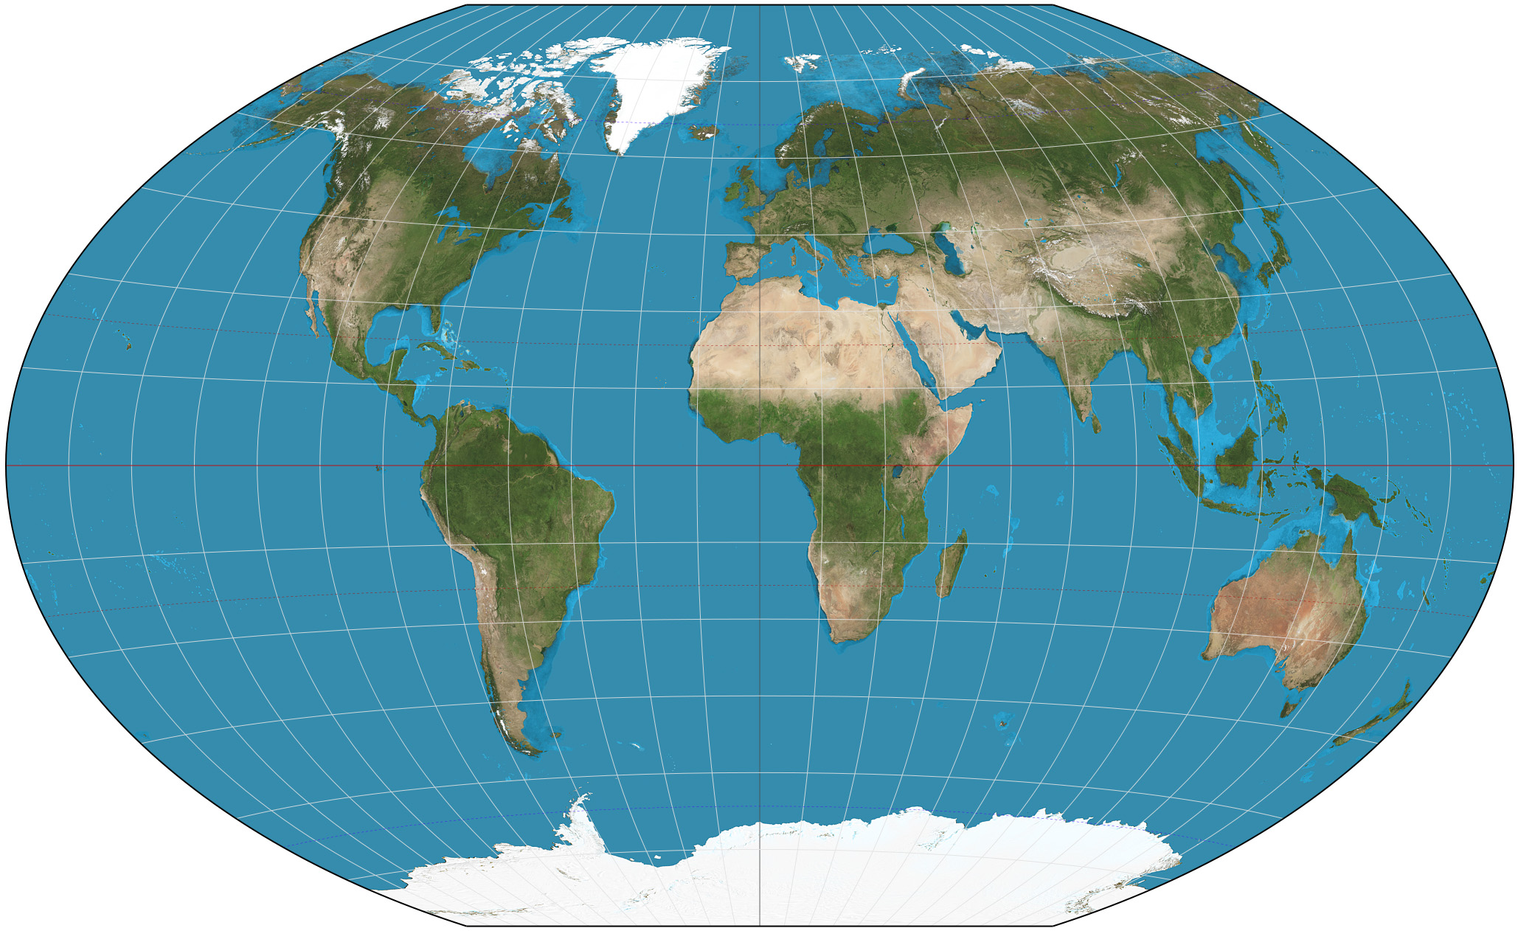
Similarities Based on Proximity
Points that are nearby spatially are likely to have similar attributes
May think of each location is a point in a 2D space (lat,long)
Measure similarity between places by their distance in 2D space

Slide 22
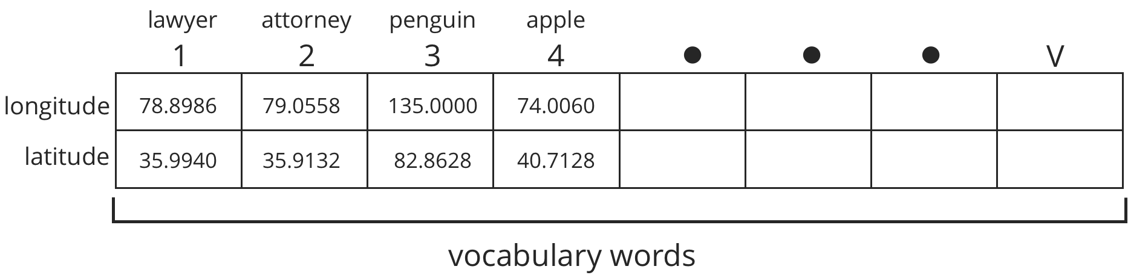
Map Each Word in Vocabulary to a Point in Space
Each word in a vocabulary is mapped to a point in a 2D space
The closer words are in the mapping, the more related/synonymous they are
The algorithm will learn the 2D point at which to place each word

Slide 23
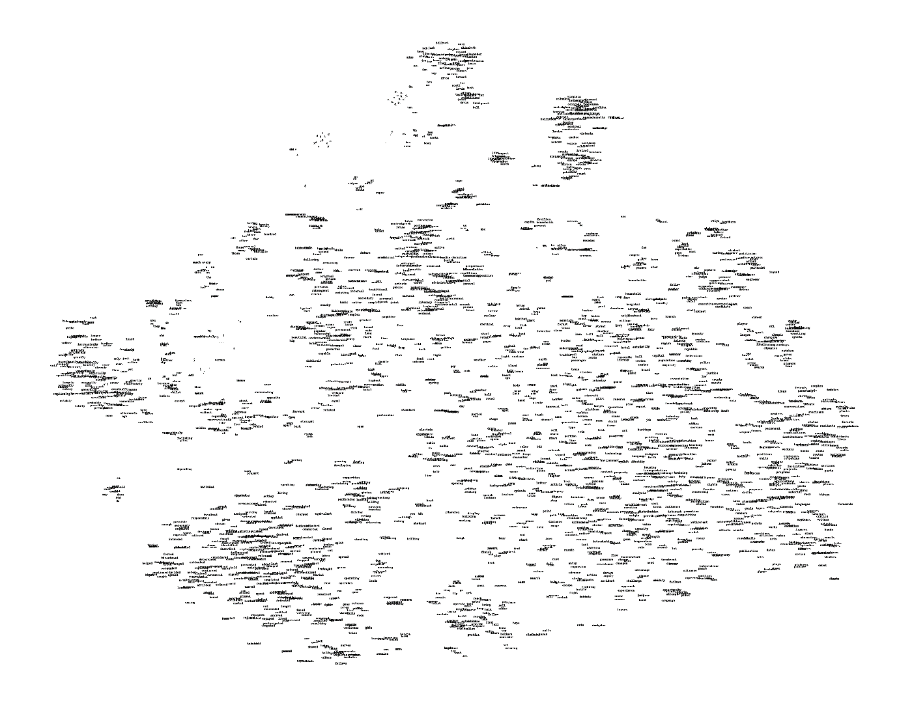
Example Word Geography
Here we show the learned geography of many different vocabulary words.
Too many words here to see! Let’s zoom in on a smaller section.

Slide 24
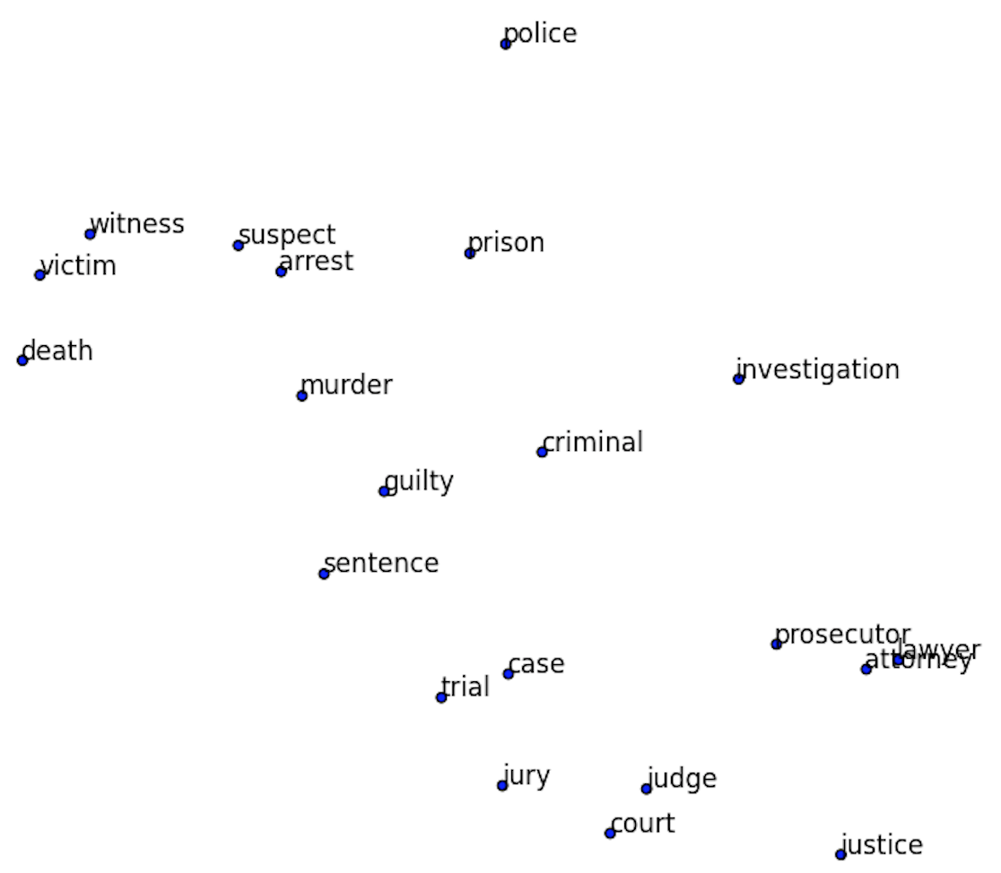
Example Word Geography
If we zoom in on a small region of our word map, it’s all related words.
Note the similarity of all the words as a whole, but also of the individual neighbors.
“Lawyer” and “attorney” are nearly identical in space!

Slide 25
Learn Geographical Relationships
The relationship between words can be maintained, we can do mathematical operations on these word vectors.
Add the same vector distance between man and woman will convert uncle to aunt and king to queen.
Plural relationships are also maintained.

Slide 26
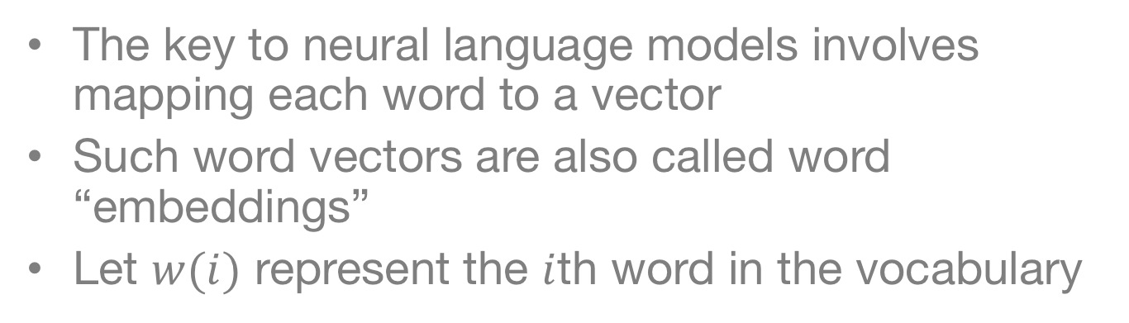
Word to Vector (Word2Vec)
The key to neural language models involves mapping each word to a vector
Such word vectors are also called word “embeddings”
Let $w(i)$ represent the $i$th word in the vocabulary

Slide 27
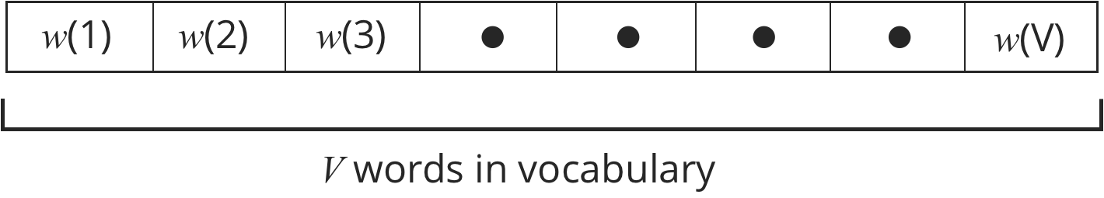
Word to Vector (Word2Vec)
Can think Word2Vec as a dictionary
Look up each word in the dictionary
If the word is in the dictionary, then we can look up the “definition” or location for it

Slide 28
Do we use 2-dimensional embeddings?

Slide 29
Do we use 2-dimensional embeddings?
2-dimensional locations are useful to illustrate similarity
Computationally, it turns out to be much easier to give each word a much longer address
Also representation is easier:
1 direction for plural
1 direction for past tense
1 direction for gender
etc…
The location vector will have M different entries
This is just like specifying a longer address (e.g. state, city, zip, street, house color, car color, etc…)

Slide 30
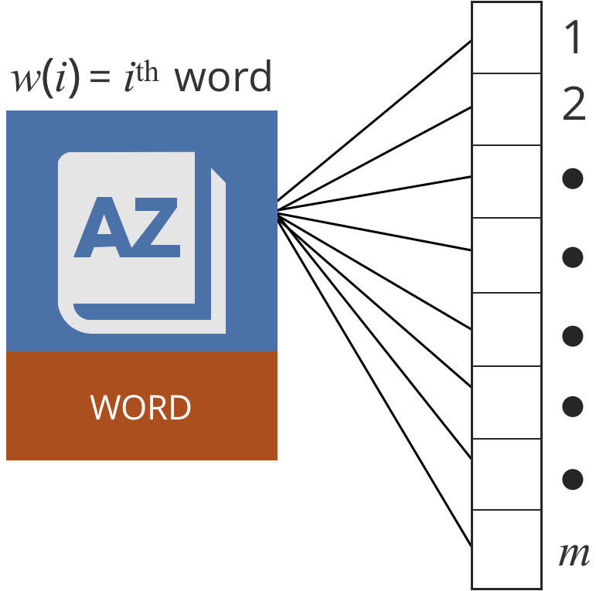
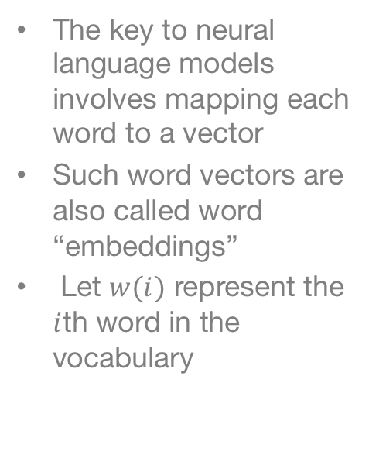
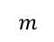
Word to Vector (Word2Vec)
The key to neural language models involves mapping each word to a vector
Such word vectors are also called word “embeddings”
Let $w(i)$ represent the $i$th word in the vocabulary
$$m$$

Slide 31
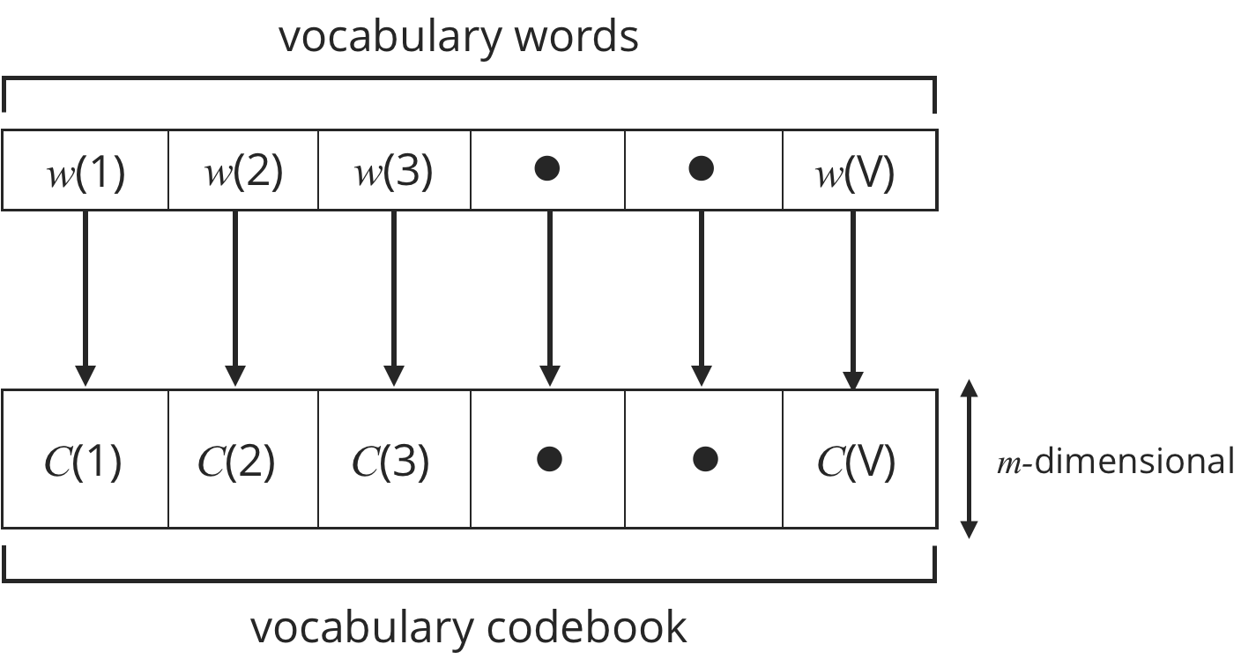
Word to Vector (Word2Vec)
The set of words in the vocabulary mapped to a codebook of vectors

Slide 32
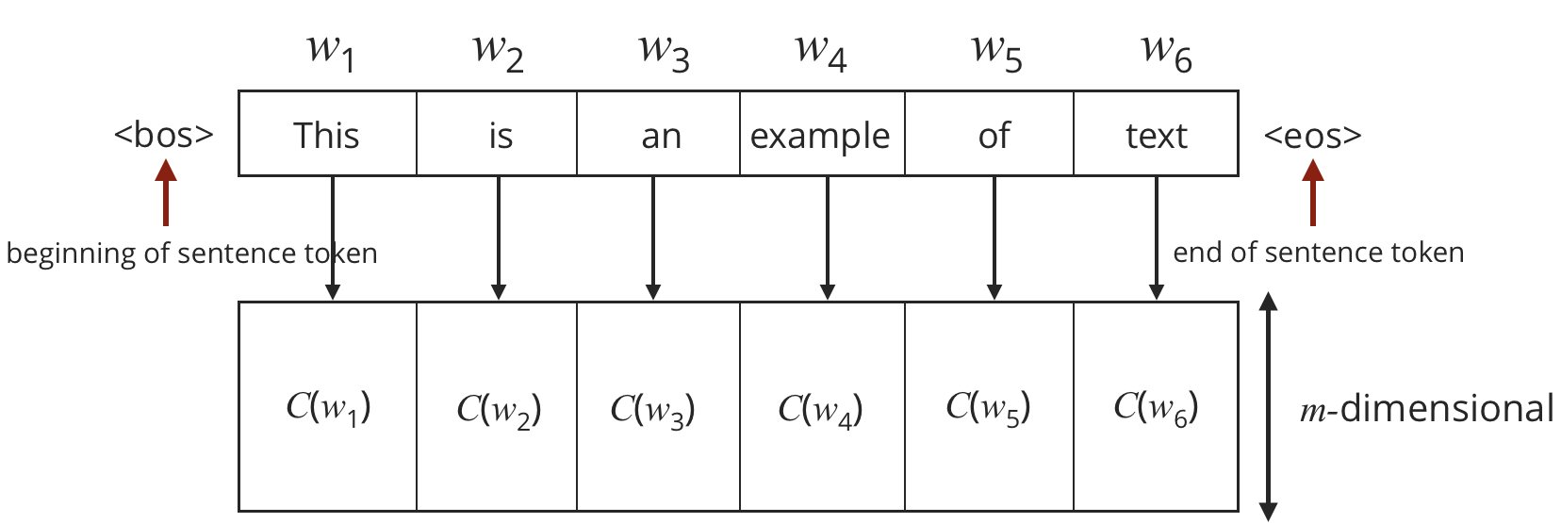
Looking up locations in a dictionary

Slide 33
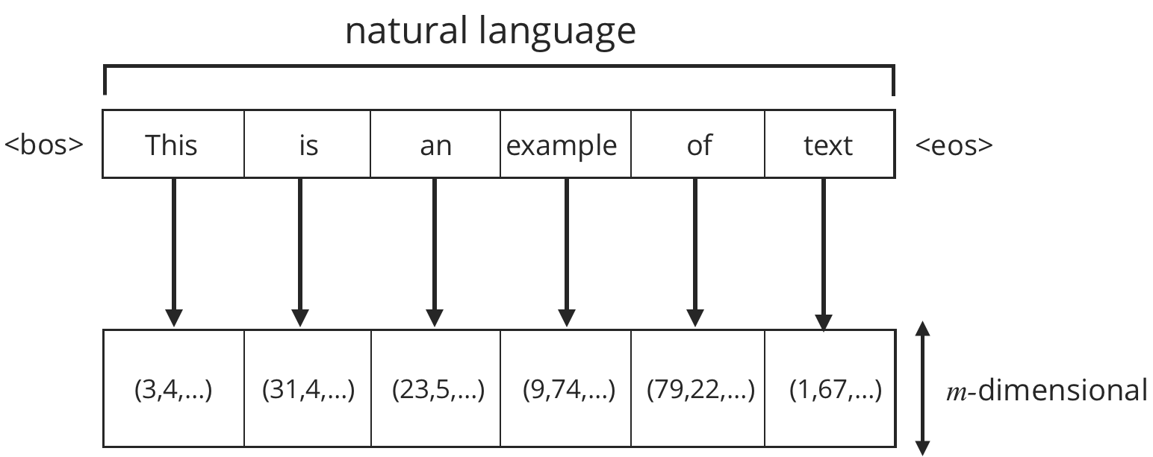
Converting a sentence to embeddings
We can construct a sequence of word embeddings to represent each sentence.
Each word is looked up in our dictionary individually
Specific tokens to mark “beginning of sentence” (<bos>) and “end of sentence” (<eos>)

Slide 34
How can we learn the dictionary?
We don’t start knowing this dictionary—must be learned from the data

Slide 35
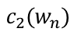
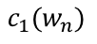
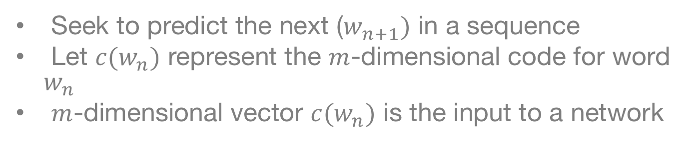
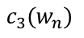
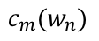
Unsupervised Learning of Word Vectors
Seek to predict the next ($w_{n+1})$ in a sequence
Let $c(w_{n})$ represent the $m$-dimensional code for word $w_{n}$
$m$-dimensional vector $c(w_{n})$ is the input to a network
$$c_{1}(w_{n})$$
$$c_{2}(w_{n})$$
$$c_{3}(w_{n})$$
$$c_{m}(w_{n})$$

Slide 36
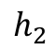
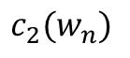
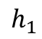
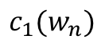
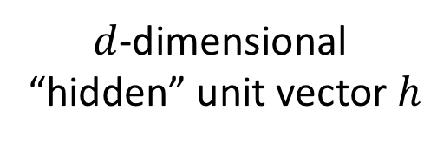
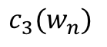



Model Construction
$$c_{1}(w_{n})$$
$$h_{1}$$
$$c_{2}(w_{n})$$
$$h_{2}$$
$$c_{3}(w_{n})$$
$$h_{3}$$
$d$-dimensional
“hidden” unit vector $h$
$$c_{m}(w_{n})$$
$$h_{d}$$

Slide 37












Model Construction
$$h_{j}=g\left[{ W}_{1j}⋅c_{1}+W_{2j}⋅ c_{2}+…+W_{mj}⋅c_{m}+b_{j}\right]$$
$$W$$
$$C_{1}$$
$$h_{1}$$
$$C_{2}$$
$$h_{2}$$
$g\left[x\right]$=tanh($x$)
$$C_{3}$$
$$h_{3}$$
$$C_{m}$$
$$h_{d}$$

Slide 38











Concise Description
$$W$$
$g\left[x\right]$=tanh($x$)
$$C_{1}$$
$$h_{1}$$
$$C_{2}$$
$$h_{2}$$
$$C_{3}$$
$$h_{3}$$
$$C_{m}$$
$$h_{d}$$
Vector
$$h=tanh\left[W⋅c+b\right]$$

Slide 39










Predicting Words
$$U$$
$$y_{1}$$
$$y_{2}$$
$$W$$
$$y_{3}$$
$$C_{1}$$
$$C_{2}$$
$$C_{3}$$
$$C_{m}$$
$$h$$
$$y_{V}$$

Slide 40

Predicting Words
$$U$$
$$y_{1}$$
$$y_{2}$$
$$W$$
$$y_{3}$$
$$C_{1}$$
$$C_{2}$$
$$C_{3}$$
Output Dimension
is $V$, our vocabulary size
$$C_{m}$$
$$h$$
$$y_{V}$$

Slide 41

Predicting Words
$$U$$
$$y_{1}$$
$$y_{2}$$
$$W$$
$$y_{3}$$
$$C_{1}$$
$$C_{2}$$
$$C_{3}$$
Output Dimension
is $V$, our vocabulary size
$$C_{m}$$
$$h$$
$$y_{V}$$
$$y_{v}={U_{1v}⋅h}_{1}+U_{2v}⋅h_{2}+⋯+{U_{dv}⋅h}_{d}+β_{v}$$
Concisely:
$$y=U⋅h+β$$

Slide 42












Predicting Words
$$U$$
$$y_{1}$$
$$y_{2}$$
$$W$$
$$y_{3}$$
$$C_{1}$$
$$C_{2}$$
$$C_{3}$$
$$C_{m}$$
$$h$$
$$y_{V}$$
Convert to probabilities:
$$p\left(w_{n+1}=i^{th} word | C\left(w_{n}\right)\right)=\frac{exp\left(y_{i}\right)}{exp\left(y_{1}\right)+exp\left(y_{2}\right)+…+exp\left(y_{V}\right)}$$

Slide 43




Predicting Words
$$U$$
$$y_{1}$$
$$p(w(1)|C)$$
$$y_{2}$$
$$p(w(2)|C)$$
$$W$$
$$y_{3}$$
$$p(w(3)|C)$$
$$C_{1}$$
$$C_{2}$$
$$C_{3}$$
Softmax
$$C_{m}$$
$$h$$
$$y_{V}$$
$$p(w(V)|C)$$
Convert to probabilities:
$$p\left(w_{n+1}=i^{th} word | C\left(w_{n}\right)\right)=\frac{exp\left(y_{i}\right)}{exp\left(y_{1}\right)+exp\left(y_{2}\right)+…+exp\left(y_{V}\right)}$$

Slide 44














Neural Text Model
$$y_{1}$$
$$p(w(1)|C)$$
$$U$$
$$y_{2}$$
$$p(w(2)|C)$$
$$W$$
$$p(w(3)|C)$$
$$y_{3}$$
$$C_{1}$$
$$C_{2}$$
$$C_{3}$$
Softmax
$$C_{m}$$
$$h$$
$$y_{V}$$
$$p(w(V)|C)$$

Slide 45
Neural Text Model
$$y_{1}$$
$$p(w(1)|C)$$
$$U$$
$$y_{2}$$
$$p(w(2)|C)$$
$$W$$
$$p(w(3)|C)$$
$$y_{3}$$
$$C_{1}$$
$$C_{2}$$
$$C_{3}$$
Softmax
$$C_{m}$$
$$h$$
$$y_{V}$$
Input: Word vector for
particular word in document
$$p(w(V)|C)$$

Slide 46
Neural Text Model
$$y_{1}$$
$$p(w(1)|C)$$
$$U$$
$$y_{2}$$
$$p(w(2)|C)$$
$$W$$
$$p(w(3)|C)$$
$$y_{3}$$
$$C_{1}$$
$$C_{2}$$
$$C_{3}$$
Softmax
$$C_{m}$$
$$h$$
$$y_{V}$$
$$p(w(V)|C)$$
Output: Probability of next word

Slide 47
Neural Text Model
$$y_{1}$$
$$p(w(1)|C)$$
$$U$$
$$y_{2}$$
$$p(w(2)|C)$$
$$W$$
$$p(w(3)|C)$$
$$y_{3}$$
$$C_{1}$$
$$C_{2}$$
$$C_{3}$$
Softmax
$$C_{m}$$
$$h$$
$$y_{V}$$
$$p(w(V)|C)$$
Will learn the word embedding to improved prediction of the next word.

Slide 48





Continuous Bag of Words (CBOW) Model
Word $n−2$
Word $n−1$
Average
Word
Vectors
Word $n$
Word $n+1$
Word $n+2$

Slide 49











Continuous Bag of Words (CBOW) Model
Word $n−2$
$$U$$
$$y_{1}$$
$$W$$
$$y_{2}$$
Word $n−1$
$$y_{3}$$
$$C_{1}$$
$$C_{2}$$
Average
Word
Vectors
$$C_{3}$$
Word $n$
Softmax
$$C_{m}$$
Word $n+1$
$$h$$
$$y_{V−1}$$
Word $n+2$

Slide 50

Continuous Bag of Words (CBOW) Model
Word $n−2$
$$U$$
$$y_{1}$$
$$W$$
$$y_{2}$$
Word $n−1$
$$y_{3}$$
$$C_{1}$$
$$C_{2}$$
Average
Word
Vectors
$$C_{3}$$
Softmax
Word $n$
Predict
Word $n$
$$C_{m}$$
Word $n+1$
$$h$$
$$y_{V−1}$$
Word $n+2$

Slide 51


Slide 52







$$U$$
$$y_{1}$$
There
$$W$$
$$y_{2}$$
$$C_{1}$$
$$y_{3}$$
Was
Average
Word
Vectors
$$C_{2}$$
Much
$$C_{3}$$
Softmax
Game
Hanging
Outside
$$C_{m}$$
The
$$h$$
$$y_{V−1}$$

Slide 53








Learning
For the CBOW setup, there is a true word, and a prediction
$$U$$
$$y_{1}$$
There
$$W$$
$$y_{2}$$
$$C_{1}$$
$$y_{3}$$
Was
Average
Word
Vectors
$$C_{2}$$
Much
$$C_{3}$$
Softmax
Game
Hanging
Outside
$$C_{m}$$
The
$$h$$
$$y_{V−1}$$

Slide 54

Learning
For the CBOW setup, there is a true word, and a prediction
$$U$$
$$y_{1}$$
There
$$W$$
$$y_{2}$$
$$C_{1}$$
$$y_{3}$$
Was
Average
Word
Vectors
$$C_{2}$$
Much
$$C_{3}$$
Softmax
Game
Hanging
Outside
$$C_{m}$$
The
$$h$$
$$y_{V−1}$$
For either form of model, learn the model parameters $C, W, U, b and β$ such that the
model yields high probabilities for the true word output
Do such model fitting across an entire, massive database of text

Slide 55












Model For Unsupervised Learning of Word Vectors
$$p(w(1)|C)$$
$$U$$
$$y_{1}$$
$$p(w(2)|C)$$
$$W$$
$$y_{2}$$
$$p(w(3)|C)$$
$$y_{3}$$
$$C_{1}$$
$$C_{2}$$
Softmax
$$C_{3}$$
$$C_{m}$$
$$h$$
$$y_{V−1}$$
$$p(w(V)|C)$$
Model parameters to be learned: $C$, $W$, $U$, $b$, $β$

Slide 56
Model For Unsupervised Learning of Word Vectors
$$p(w(1)|C)$$
$$U$$
$$y_{1}$$
$$p(w(2)|C)$$
$$W$$
$$y_{2}$$
$$p(w(3)|C)$$
$$y_{3}$$
$$C_{1}$$
$$C_{2}$$
Softmax
$$C_{3}$$
$$C_{m}$$
$$h$$
$$y_{V−1}$$
$$p(w(V)|C)$$
Word Vectors
Model parameters to be learned: $C$, $W$, $U$, $b$, $β$

Slide 57
Model For Unsupervised Learning of Word Vectors
$$p(w(1)|C)$$
$$U$$
$$y_{1}$$
$$p(w(2)|C)$$
$$W$$
$$y_{2}$$
$$p(w(3)|C)$$
$$y_{3}$$
$$C_{1}$$
$$C_{2}$$
Softmax
$$C_{3}$$
$$C_{m}$$
$$h$$
$$y_{V−1}$$
$$p(w(V)|C)$$
MLP Weights
Model parameters to be learned: $C$, $W$, $U$, $b$, $β$

Slide 58
Model For Unsupervised Learning of Word Vectors
$$p(w(1)|C)$$
$$U$$
$$y_{1}$$
$$p(w(2)|C)$$
$$W$$
$$y_{2}$$
$$p(w(3)|C)$$
$$y_{3}$$
$$C_{1}$$
$$C_{2}$$
Softmax
$$C_{3}$$
$$C_{m}$$
$$h$$
$$y_{V−1}$$
$$p(w(V)|C)$$
MLP Biases
Model parameters to be learned: $C$, $W$, $U$, $b$, $β$

Slide 59
Some Comments
This forms the basis of a text model
Can learn the dictionary to minimize the associated loss (i.e. predict next words as well as possible)
Can incorporate a larger history (more words)? Can we do this automatically?
How do we make this useful for predictions?

Slide 60
Lecture 2

Slide 61
Learning model parameters

Slide 62


Learning
Assume that we employ such learning for $M$ word examples from our corpus
Represent the model as
$$p(w_{out}|w_{in };θ)$$

Slide 63
Learning
Assume that we employ such learning for $M$ word examples from our corpus
Represent the model as
$$p(w_{out}|w_{in };θ)$$
Probability of Output Word
From Neural Network (via Softmax)

Slide 64
Learning
Assume that we employ such learning for $M$ word examples from our corpus
Represent the model as
Contextual Word(s)
Defining Input to Neural Network
$$p(w_{out}|w_{in };θ)$$

Slide 65
Learning
Assume that we employ such learning for $M$ word examples from our corpus
Represent the model as
$$p(w_{out}|w_{in };θ)$$
Neural Network Model Parameters
𝐶, 𝑊, 𝑈, 𝑏, 𝛽

Slide 66


Learning
Assume that we employ such learning for $M$ word examples from our corpus
Represent the model as
Via $M$ examples from our corpus, ${\left\{\left(w_{in}^{i},w_{out}^{i}\right)\right\}}_{i=1,M},$we constitute
$$p(w_{out}|w_{in };θ)$$
$$f\left(θ;Data\right)=log p\left(w_{out}^{1} | w_{in}^{1};θ\right)+log p\left(w_{out}^{2} | w_{in}^{2};θ\right)+⋯+log p\left(w_{out}^{M} | w_{in}^{M};θ\right)$$

Slide 67

Learning
Assume that we employ such learning for $M$ word examples from our corpus
Represent the model as
Via $M$ examples from our corpus, ${\left\{\left(w_{in}^{i},w_{out}^{i}\right)\right\}}_{i=1,M},$we constitute
Seek model parameters $θ$ that maximize $f\left(θ;Data\right)$
$$p(w_{out}|w_{in };θ)$$
$$f\left(θ;Data\right)=log p\left(w_{out}^{1} | w_{in}^{1};θ\right)+log p\left(w_{out}^{2} | w_{in}^{2};θ\right)+⋯+log p\left(w_{out}^{M} | w_{in}^{M};θ\right)$$

Slide 68
Recurrent Neural Networks

Slide 69
Generating Text
Assume we have learned word embeddings (vectors) Want to use these embeddings in applications
Text synthesis may be of interest for automatic captioning of images, and for translation from one language to another
These tools are quite useful generally (will discuss in case studies)
We require additional tools for text synthesis: The recurrent neural network (RNN)

Slide 70

Using Word Embeddings
Our representation depends on the number of words
Not a constant number of features!

Slide 71













Recurrent Neural Network
Sequence of Word
Embeddings (sentence)
Model-Predicted
Next Word
$$h_{n−1}$$
Neural
Network
$$h_{n}$$
$$w_{n−1}$$
Softmax
$$w_{n}$$
$$h_{n}$$
Neural
Network
$$h_{n+1}$$
$$w_{n}$$
Softmax
$$w_{n+1}$$
$$h_{n+1}$$
Neural
Network
$$w_{n+1}$$
Softmax
$$w_{n+2}$$
$$h_{n+2}$$

Slide 72






Recurrent Neural Network
Sequence of Word
Embeddings (sentence)
Model-Predicted
Next Word
$$h_{n−1}$$
Neural
Network
$$h_{n}$$
$$w_{n−1}$$
Softmax
$$w_{n}$$
$$h_{n}$$
Neural
Network
$$h_{n+1}$$
$$w_{n}$$
Softmax
$$w_{n+1}$$
$$h_{n+1}$$
Neural
Network
$$w_{n+1}$$
Softmax
$$w_{n+2}$$
$$h_{n+2}$$

Slide 73
Recurrent Neural Network
Sequence of Word
Embeddings (sentence)
Model-Predicted
Next Word
$$h_{n−1}$$
Neural
Network
$$h_{n}$$
$$w_{n−1}$$
Softmax
$$w_{n}$$
$$h_{n}$$

Slide 74
Recurrent Neural Network
Sequence of Word
Embeddings (sentence)
Model-Predicted
Next Word
$$h_{n−1}$$
Neural
Network
$$h_{n}$$
$$w_{n−1}$$
Softmax
$$w_{n}$$
$$h_{n}$$

Slide 75


Recurrent Neural Network
Sequence of Word
Embeddings (sentence)
Model-Predicted
Next Word
$$h_{n−1}$$
Neural
Network
$$h_{n}$$
$$w_{n−1}$$
Softmax
$$w_{n}$$
$$h_{n}$$
Concatenate
$$Vector for w_{n−1}$$
$$h_{n−1}$$

Slide 76




Recurrent Neural Network
Sequence of Word
Embeddings (sentence)
Model-Predicted
Next Word
$$h_{n−1}$$
Neural
Network
$$h_{n}$$
$$w_{n−1}$$
Softmax
$$w_{n}$$
$$h_{n}$$
Concatenate
$$W$$
$$Vector for w_{n−1}$$
$$h_{n−1}$$
$$h_{n}$$

Slide 77



Recurrent Neural Network
Sequence of Word
Embeddings (sentence)
Model-Predicted
Next Word
$$h_{n−1}$$
Neural
Network
$$h_{n}$$
$$w_{n−1}$$
Softmax
$$w_{n}$$
$$h_{n}$$
$$W$$
$$Vector for w_{n−1}$$
$$h_{n−1}$$
$$h_{n}$$

Slide 78








Recurrent Neural Network
Sequence of Word
Embeddings (sentence)
Model-Predicted
Next Word
$$h_{n−1}$$
Neural
Network
$$h_{n}$$
$$w_{n−1}$$
Softmax
$$w_{n}$$
$$h_{n}$$
$$U$$
$$y_{1}$$
$$y_{2}$$
$$W$$
$$y_{3}$$
Softmax
$$Vector for w_{n−1}$$
$$h_{n−1}$$
$$h_{n}$$
$$y_{V−1}$$

Slide 79










Introduce Notation
$$U$$
$$y_{1}$$
$$y_{2}$$
$$W$$
$$y_{3}$$
Softmax
$$Vector for w_{n−1}$$
$$h_{n−1}$$
$$h_{n}$$
$$y_{V−1}$$
$$x_{n−1}$$
$$h_{n}=tanh(W⋅x_{n−1}+b)$$
$$p(w_{n}|w_{n−1},h_{n−1})=softmax(U⋅h_{n}+β)$$

Slide 80











Intuition on Model for Predicting nth Word
$$U$$
$$y_{1}$$
$$y_{2}$$
$$W$$
$$y_{3}$$
Softmax
$$Vector for w_{n−1}$$
$$h_{n−1}$$
$$h_{n}$$
$$y_{V−1}$$
$$x_{n−1}$$
$h_{n−1}:$Tells us which words were likely prior to selection of previous word (context)
$w_{n−1}$: Tells us which word was used/selected at point $n−1$ in text, as we predict the $n$th word

Slide 81
Recurrent Neural Network
Sequence of Word
Embeddings (sentence)
Model-Predicted
Next Word
$$h_{n−1}$$
Neural
Network
$$h_{n}$$
$$w_{n−1}$$
Softmax
$$w_{n}$$
$$h_{n}$$
Neural
Network
$$h_{n+1}$$
$$w_{n}$$
Softmax
$$w_{n+1}$$
$$h_{n+1}$$
Neural
Network
$$w_{n+1}$$
Softmax
$$w_{n+2}$$
$$h_{n+2}$$

Slide 82
Generating Text
Sequence of Word
Embeddings (sentence)
Model-Predicted
Next Word
$$h_{n−1}$$
Neural
Network
$$h_{n}$$
$$w_{n−1}$$
Softmax
$$w_{n}$$
$$h_{n}$$
Neural
Network
$$h_{n+1}$$
$$w_{n}$$
Softmax
$$w_{n+1}$$
$$h_{n+1}$$
Neural
Network
$$w_{n+1}$$
Softmax
$$w_{n+2}$$
$$h_{n+2}$$

Slide 83

Predicting a Single Output
Sequence of Word
Embeddings (sentence)
$$h_{n−1}$$
$$w_{n−1}$$
Neural
Network
$$h_{n}$$
Neural
Network
$$w_{n}$$
$$h_{n+1}$$
Neural
Network
$$<EOS>$$
Sigmoid
Predict at the end of the text.

Slide 84
















RNN with Memory Cells & Outputs
Sequence of Word
Embeddings (sentence)
Model-Predicted
Next Word
$$h_{n−1}$$
$$c_{n−1}$$
Neural
Network
$$h_{n}$$
$$w_{n−1}$$
Softmax
$$w_{n}$$
$$h_{n}$$
$$c_{n}$$
Neural
Network
$$h_{n+1}$$
$$w_{n}$$
Softmax
$$w_{n+1}$$
$$h_{n+1}$$
$$c_{n+1}$$
Neural
Network
$$w_{n+1}$$
Softmax
$$w_{n+2}$$
$$h_{n+2}$$
$$c_{n+2}$$

Slide 85
RNN with Memory Cells & Outputs
Sequence of Word
Embeddings (sentence)
Model-Predicted
Next Word
$$h_{n−1}$$
$$c_{n−1}$$
Neural
Network
$$h_{n}$$
$$w_{n−1}$$
Softmax
$$w_{n}$$
$$h_{n}$$
$$c_{n}$$
Neural
Network
$$h_{n+1}$$
$$w_{n}$$
Softmax
$$w_{n+1}$$
$$h_{n+1}$$
$$c_{n+1}$$
Neural
Network
$$w_{n+1}$$
Softmax
$$w_{n+2}$$
$$h_{n+2}$$
$$c_{n+2}$$
Memory Cells

Slide 86
RNN with Memory Cells & Outputs
Sequence of Word
Embeddings (sentence)
Model-Predicted
Next Word
$$h_{n−1}$$
$$c_{n−1}$$
Neural
Network
$$h_{n}$$
$$w_{n−1}$$
Softmax
$$w_{n}$$
$$h_{n}$$
$$c_{n}$$
Neural
Network
$$h_{n+1}$$
$$w_{n}$$
Softmax
$$w_{n+1}$$
$$h_{n+1}$$
$$c_{n+1}$$
Neural
Network
$$w_{n+1}$$
Softmax
$$w_{n+2}$$
$$h_{n+2}$$
$$c_{n+2}$$
Hidden Units

Slide 87






Recall Notation
$$W$$
$$Vector for w_{n−1}$$
$$h_{n−1}$$
$$h_{n}$$
$$x_{n−1}$$
Nonlinear function
$$h_{n}=f(W⋅x_{n−1}+b)$$

Slide 88


Tanh Nonlinear Function
$$h_{n}=tanh(W⋅x_{n−1}+b)$$

Slide 89


Sigmoid Nonlinear Function
Nonlinear function
$$h_{n}=σ(W⋅x_{n−1}+b)$$

Slide 90


RNN with Memory Cells & Outputs
Sequence of Word
Embeddings (sentence)
Model-Predicted
Next Word
$$h_{n−1}$$
$$c_{n−1}$$
Neural
Network
$$h_{n}$$
$$w_{n−1}$$
Softmax
$$w_{n}$$
$$h_{n}$$
$$c_{n}$$
As before, concatenate $w_{n−1} and h_{n−1} to constitute$
$$x_{n−1}=[w_{n−1},h_{n−1}]$$

Slide 91




RNN with Memory Cells & Outputs
Sequence of Word
Embeddings (sentence)
Model-Predicted
Next Word
$$h_{n−1}$$
$$c_{n−1}$$
Neural
Network
$$h_{n}$$
$$w_{n−1}$$
Softmax
$$w_{n}$$
$$h_{n}$$
$$c_{n}$$
As before, concatenate $w_{n−1} and h_{n−1} to constitute$
Introduce three control-gate vectors, $i_{n}, f_{n}, {and o}_{n}:$
$$x_{n−1}=[w_{n−1},h_{n−1}]$$
$$i_{n}=σ(W_{i}⋅x_{n−1}+b_{i})$$
$$f_{n}=σ(W_{f}⋅x_{n−1}+b_{f})$$
$$o_{n}=σ(W_{o}⋅x_{n−1}+b_{o})$$

Slide 92
RNN with Memory Cells & Outputs
Sequence of Word
Embeddings (sentence)
Model-Predicted
Next Word
$$h_{n−1}$$
$$c_{n−1}$$
Neural
Network
$$h_{n}$$
$$w_{n−1}$$
Softmax
$$w_{n}$$
$$h_{n}$$
$$c_{n}$$
As before, concatenate $w_{n−1} and h_{n−1} to constitute$
Introduce three control-gate vectors, $i_{n}, f_{n}, {and o}_{n}:$
$$x_{n−1}=[w_{n−1},h_{n−1}]$$
$$i_{n}=σ(W_{i}⋅x_{n−1}+b_{i})$$
$$f_{n}=σ(W_{f}⋅x_{n−1}+b_{f})$$
$$o_{n}=σ(W_{o}⋅x_{n−1}+b_{o})$$

Slide 93




RNN with Memory Cells & Outputs
Sequence of Word
Embeddings (sentence)
Model-Predicted
Next Word
$$h_{n−1}$$
$$c_{n−1}$$
Neural
Network
$$h_{n}$$
$$w_{n−1}$$
Softmax
$$w_{n}$$
$$h_{n}$$
$$c_{n}$$
$$o_{n}=σ(W_{o}⋅x_{n−1}+b_{o})$$
$$f_{n}=σ(W_{f}⋅x_{n−1}+b_{f})$$
$$i_{n}=σ(W_{i}⋅x_{n−1}+b_{i})$$
We introduce three distinct control neural networks, with respective weights
and biases $W_{o}, W_{f}, W_{i}, b_{o}, b_{f}, and b_{i}$
The outputs of these three neural networks, $o, f, i,$ are each vectors, the components
of which are each between zero and one

Slide 94



RNN with Memory Cells & Outputs
Sequence of Word
Embeddings (sentence)
Model-Predicted
Next Word
$$h_{n−1}$$
$$c_{n−1}$$
Neural
Network
$$h_{n}$$
$$w_{n−1}$$
Softmax
$$w_{n}$$
$$h_{n}$$
$$c_{n}$$
New estimate of memory-cell values
Update the memory cell as
$${\tilde{c}}_{n}=tanh(W_{c}⋅x_{n−1}+b_{c})$$
$$c_{n}=f_{n}⊙c_{n−1}+i_{n}⊙{\tilde{c}}_{n}$$

Slide 95
RNN with Memory Cells & Outputs
Sequence of Word
Embeddings (sentence)
Model-Predicted
Next Word
$$h_{n−1}$$
$$c_{n−1}$$
Neural
Network
$$h_{n}$$
$$w_{n−1}$$
Softmax
$$w_{n}$$
$$h_{n}$$
$$c_{n}$$
New estimate of memory-cell values
Update the memory cell as
$${\tilde{c}}_{n}=tanh(W_{c}⋅x_{n−1}+b_{c})$$
$$c_{n}=f_{n}⊙c_{n−1}+i_{n}⊙{\tilde{c}}_{n}$$

Slide 96


RNN with Memory Cells & Outputs
Sequence of Word
Embeddings (sentence)
Model-Predicted
Next Word
$$h_{n−1}$$
$$c_{n−1}$$
Neural
Network
$$h_{n}$$
$$w_{n−1}$$
Softmax
$$w_{n}$$
$$h_{n}$$
$$c_{n}$$
$${\tilde{c}}_{n}=tanh(W_{c}⋅x_{n−1}+b_{c})$$
$$c_{n}=f_{n}⊙c_{n−1}+i_{n}⊙{\tilde{c}}_{n}$$

Slide 97





RNN with Memory Cells & Outputs
Sequence of Word
Embeddings (sentence)
Model-Predicted
Next Word
$$h_{n−1}$$
$$c_{n−1}$$
Neural
Network
$$h_{n}$$
$$w_{n−1}$$
Softmax
$$w_{n}$$
$$h_{n}$$
$$c_{n}$$
$${\tilde{c}}_{n}=tanh(W_{c}⋅x_{n−1}+b_{c})$$
$$c_{n}=f_{n}⊙c_{n−1}+i_{n}⊙{\tilde{c}}_{n}$$
$$f_{n}$$
$$×$$
$$×$$
$$⋯$$
$$×$$
$$c_{n−1}$$

Slide 98








RNN with Memory Cells & Outputs
Sequence of Word
Embeddings (sentence)
Model-Predicted
Next Word
$$h_{n−1}$$
$$c_{n−1}$$
Neural
Network
$$h_{n}$$
$$w_{n−1}$$
Softmax
$$w_{n}$$
$$h_{n}$$
$$c_{n}$$
$${\tilde{c}}_{n}=tanh(W_{c}⋅x_{n−1}+b_{c})$$
$$c_{n}=f_{n}⊙c_{n−1}+i_{n}⊙{\tilde{c}}_{n}$$
$$f_{n}$$
$$×$$
$$×$$
$$⋯$$
$$×$$
$$c_{n−1}$$
$$f_{n}⊙c_{n−1}$$

Slide 99
RNN with Memory Cells & Outputs
Sequence of Word
Embeddings (sentence)
Model-Predicted
Next Word
$$h_{n−1}$$
$$c_{n−1}$$
Neural
Network
$$h_{n}$$
$$w_{n−1}$$
Softmax
$$w_{n}$$
$$h_{n}$$
$$c_{n}$$

Slide 100

RNN with Memory Cells & Outputs
Sequence of Word
Embeddings (sentence)
Model-Predicted
Next Word
$$h_{n−1}$$
$$c_{n−1}$$
Neural
Network
$$h_{n}$$
$$w_{n−1}$$
Softmax
$$w_{n}$$
$$h_{n}$$
$$c_{n}$$
$$x_{n−1}=[w_{n−1},h_{n−1}]$$

Slide 101




RNN with Memory Cells & Outputs
Sequence of Word
Embeddings (sentence)
Model-Predicted
Next Word
$$h_{n−1}$$
$$c_{n−1}$$
Neural
Network
$$h_{n}$$
$$w_{n−1}$$
Softmax
$$w_{n}$$
$$h_{n}$$
$$c_{n}$$
$$o_{n}=σ(W_{o}⋅x_{n−1}+b_{o})$$
$$f_{n}=σ(W_{f}⋅x_{n−1}+b_{f})$$
$$i_{n}=σ(W_{i}⋅x_{n−1}+b_{i})$$
$${\tilde{c}}_{n}=tanh(W_{c}⋅x_{n−1}+b_{c})$$
Four Neural Networks

Slide 102

RNN with Memory Cells & Outputs
Sequence of Word
Embeddings (sentence)
Model-Predicted
Next Word
$$h_{n−1}$$
$$c_{n−1}$$
Neural
Network
$$h_{n}$$
$$w_{n−1}$$
Softmax
$$w_{n}$$
$$h_{n}$$
$$c_{n}$$
$$o_{n}=σ(W_{o}⋅x_{n−1}+b_{o})$$
$$f_{n}=σ(W_{f}⋅x_{n−1}+b_{f})$$
$$i_{n}=σ(W_{i}⋅x_{n−1}+b_{i})$$
$${\tilde{c}}_{n}=tanh(W_{c}⋅x_{n−1}+b_{c})$$
$$c_{n}=f_{n}⊙c_{n−1}+i_{n}⊙{\tilde{c}}_{n}$$
Update Memory Cell

Slide 103

RNN with Memory Cells & Outputs
Sequence of Word
Embeddings (sentence)
Model-Predicted
Next Word
$$h_{n−1}$$
$$c_{n−1}$$
Neural
Network
$$h_{n}$$
$$w_{n−1}$$
Softmax
$$w_{n}$$
$$h_{n}$$
$$c_{n}$$
$$o_{n}=σ(W_{o}⋅x_{n−1}+b_{o})$$
$$f_{n}=σ(W_{f}⋅x_{n−1}+b_{f})$$
$$i_{n}=σ(W_{i}⋅x_{n−1}+b_{i})$$
$${\tilde{c}}_{n}=tanh(W_{c}⋅x_{n−1}+b_{c})$$
$$c_{n}=f_{n}⊙c_{n−1}+i_{n}⊙{\tilde{c}}_{n}$$
$$h_{n}=o_{n}⊙{tanh(c}_{n})$$
Update Memory Cell
Output Hidden Vector

Slide 104







LSTM-Based Text Synthesis
Assume we have trained the parameters of an LSTM using a large document corpus
How may we use the LSTM to synthesize text?
Use Most Likely
Word from Softmax
$$h_{0}$$
$$c_{0}$$
Neural
Network
$$h_{1}$$
$$<bos>$$
Softmax
$$w_{1}$$
$$h_{1}$$
$$c_{1}$$

Slide 105




LSTM-Based Text Synthesis
$$h_{0}$$
$$c_{0}$$
Neural
Network
$$h_{1}$$
$$<bos>$$
Softmax
$$w_{1}$$
$$h_{1}$$
$$c_{1}$$

Slide 106




LSTM-Based Text Synthesis
$$h_{0}$$
$$c_{0}$$
Neural
Network
$$h_{1}$$
$$<bos>$$
Softmax
$$w_{1}$$
$$h_{1}$$
$$c_{1}$$
Neural
Network
$$h_{2}$$
$$w_{1}$$
$$h_{2}$$
$$c_{2}$$

Slide 107

LSTM-Based Text Synthesis
$$h_{0}$$
$$c_{0}$$
Neural
Network
$$h_{1}$$
$$<bos>$$
Softmax
$$w_{1}$$
$$h_{1}$$
$$c_{1}$$
Use Most Likely
Word from Softmax
Neural
Network
$$h_{2}$$
$$w_{1}$$
Softmax
$$w_{2}$$
$$h_{2}$$
$$c_{2}$$

Slide 108



LSTM-Based Text Synthesis
$$h_{0}$$
$$c_{0}$$
Neural
Network
$$h_{1}$$
$$<bos>$$
Softmax
$$w_{1}$$
Use Most Likely
Word from Softmax
$$h_{1}$$
$$c_{1}$$
Neural
Network
$$h_{2}$$
$$w_{1}$$
Softmax
$$w_{2}$$
$$h_{2}$$
$$c_{2}$$
Neural
Network
$$w_{2}$$
$$h_{3}$$
$$c_{3}$$

Slide 109



LSTM-Based Text Synthesis
$$h_{0}$$
$$c_{0}$$
Neural
Network
$$h_{1}$$
$$<bos>$$
Neural
Network
Softmax
$$w_{1}$$
$$h_{1}$$
$$c_{1}$$
Neural
Network
$$h_{2}$$
$$w_{1}$$
Softmax
$$w_{2}$$
Use Most Likely
Word from Softmax
$$h_{2}$$
$$c_{2}$$
Neural
Network
$$h_{3}$$
$$w_{2}$$
Softmax
$$w_{3}$$
$$h_{3}$$
$$c_{3}$$

Slide 110
LSTM-Based Text Synthesis
$$h_{0}$$
$$c_{0}$$
Neural
Network
$$h_{1}$$
$$<bos>$$
Neural
Network
Softmax
$$w_{1}$$
$$h_{1}$$
$$c_{1}$$
Neural
Network
$$h_{2}$$
$$w_{1}$$
Softmax
$$w_{2}$$
Use Most Likely
Word from Softmax
$$h_{2}$$
$$c_{2}$$
Neural
Network
$$h_{3}$$
$$w_{2}$$
Softmax
$$w_{3}$$
$$h_{3}$$
$$c_{3}$$

Slide 111
Image-to-Caption

Slide 112
Text Translation
translate.google.com

Slide 113
Conclusions
Word embeddings and recurrent neural networks are currently the cornerstones of natural language processing
Nearly all text systems are based on these techniques (e.g. google translate, chatbots, etc.)
Many more versions of Recurrent Neural Networks
Long-Short Term Memory (LSTM) to build a “memory”
Stacking recurrent units to make deep recurrent networks
The Transformer Network is a new variant that achieves similar goals

